Slide 1
Almost everything you need to know about PLS
Part 2: PLS for functional neuroimaging with MatLab
Jenny Rieck & Derek Beaton
23 April 2021

Slide 2
Intro to PLS in Functional NeuroImaging
PLSC computed as the SVD of the cross-product matrix of X and Y
X is a matrix of observations by variables
Y is a matrix of those same observations by (some other) variables
PLSC neuroimaging:
One matrix is generally “brain”
The other matrix is generally “behavior” or experimental conditions/groups
“Brain” can come in many forms:
Tabular data (e.g., composite brain measures)
One brain volume per participant (e.g., structural MRI, fMRI contrast maps)
Many brain volumes (e.g., time series in functional MRI)
Not-quite-brain volumes (e.g., functional connectivity)

Slide 3
Why use PLS for fMRI data?
Brian data are large
10k -100k brain variables
100s of timepoints
Experimental designs are complex
Task conditions or different participant groups
Research questions are complex and open to exploration
Many brain variables with many behavior variables

Slide 4
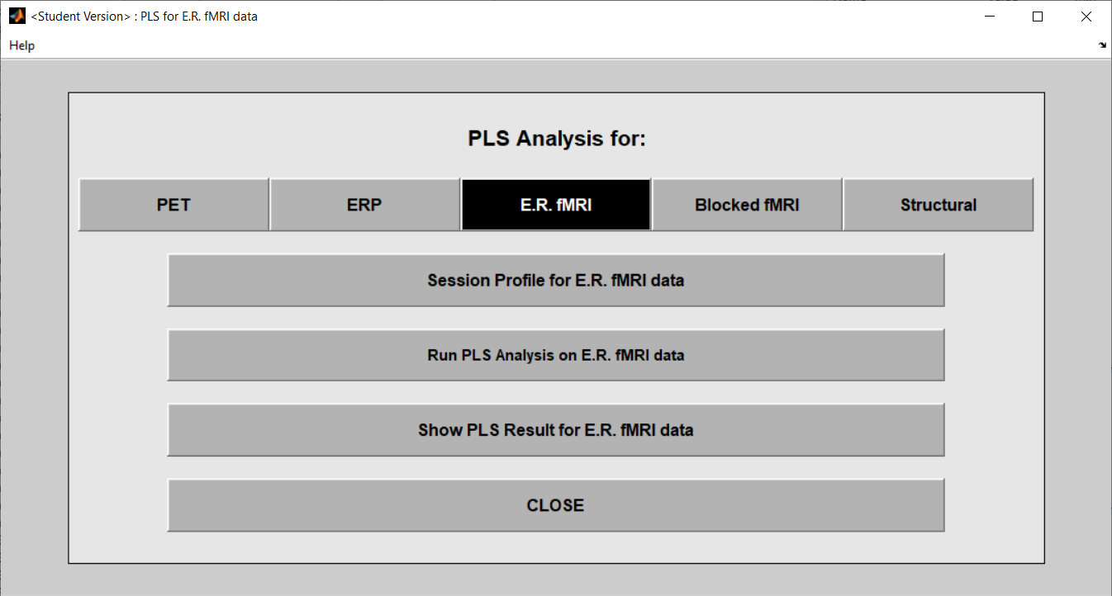
PLS Toolbox in MatLab (McIntosh & Lobaugh, 2004)
One 3D brain volume
(3D .nii or .img/.hdr)
Multi- 3D brain volumes
(4D .nii or .img/.hdr)
ERP
(BESA output)

Slide 5
PLS Toolbox in MatLab (McIntosh & Lobaugh, 2004)
0. Prepare your data
1.
1. Make “brain” matrix
2.
2. Run PLS

Slide 6
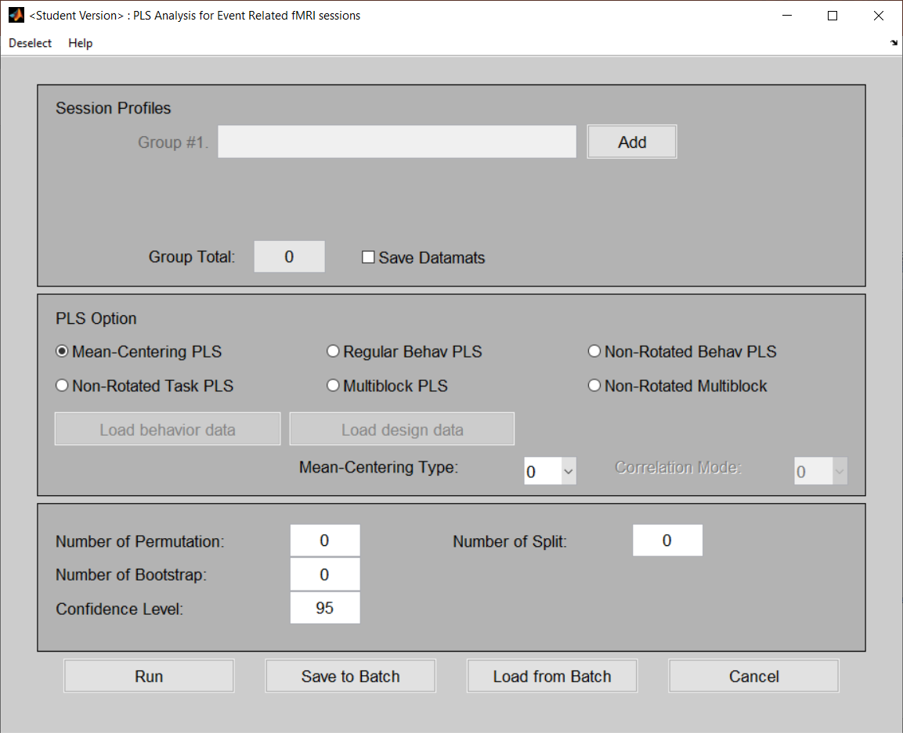
PLS Analysis Options
For today:
Mean-Centered PLS
Behavioral PLS

Slide 7
PLS Toolbox in MatLab (McIntosh & Lobaugh, 2004)
0. Prepare your data
1.
1. Make “brain” matrix
2.
2. Run PLS
3.
3. Visualize and interpret
Steps 1-3 can be done via PLSgui or MatLab command line functions

Slide 8
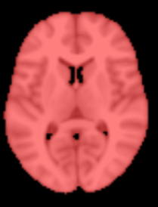
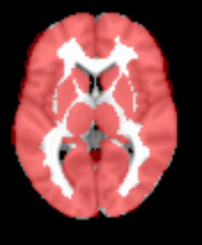
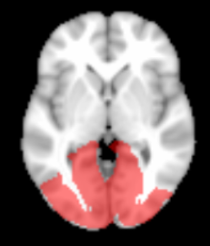
Pre-PLS data prep
Conduct the “standard” preprocessing pipeline for your data
E.g., for fMRI: co-registration, slice timing correction, detrending, denoising, smoothing, warping to a common space
Create a brain mask
whole brain
exclude white matter
region specific

Slide 9
Pre-PLS data prep
For task-based fMRI, you’ll need experiment/task information
Onsets and durations for each trial/condition
TR length (how long to acquire each volume)
Optional: participant’s response/performance

Slide 10
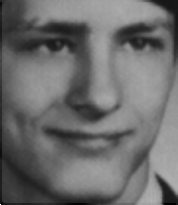
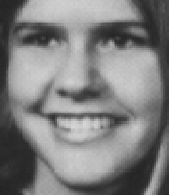
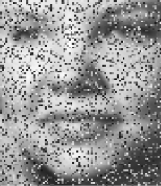
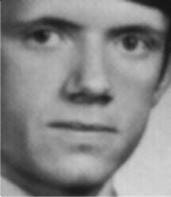
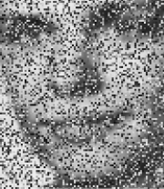
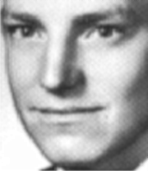
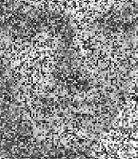
Block-design fMRI face match task
Garrett, McIntosh, & Grady, 2014, Cereb Cortex
Sample: N = 20 younger adults, N = 20 older adults
Face-matching task (with one face degraded):
Block Design
5 face-match trials/block
20 sec fixation
0% (D0)
30% (D30)
50% (D50)
70% (D70)
Notes:
Why PLS for this data?

Slide 11
Face-matching task questions
What are the patterns of activity underlying different levels of face degradation during a face matching task?
How do patterns of brain activity differ as a function of task difficulty or age group?

Slide 12
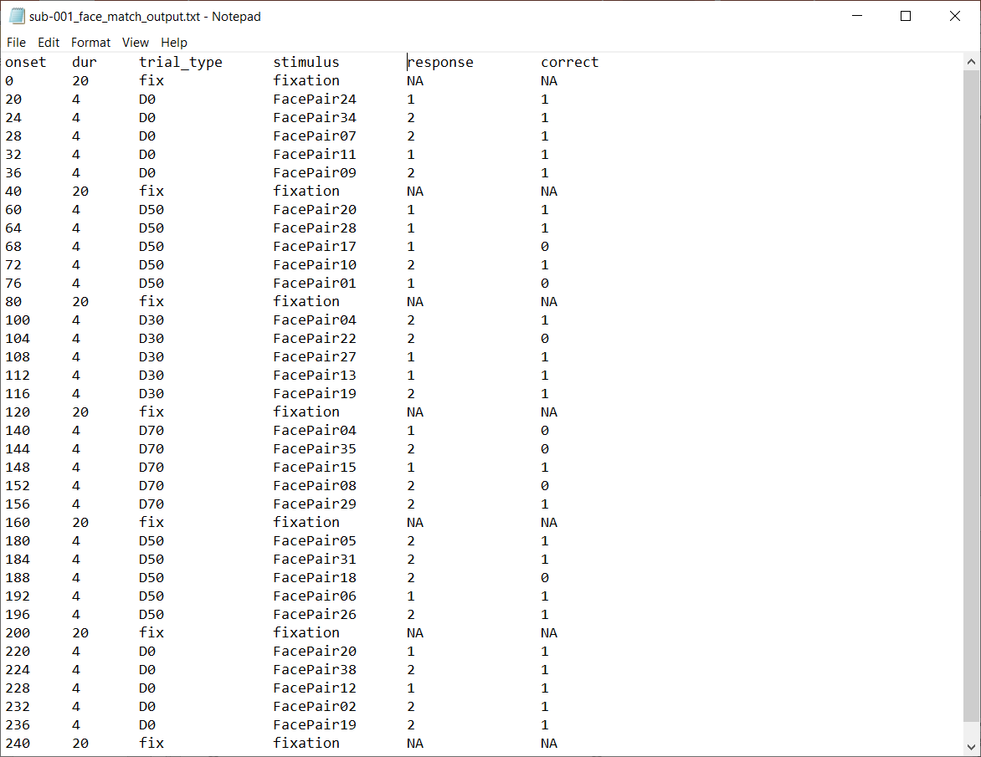
Typical experiment output file for 1 subject

Slide 13
Convert onset timing (sec) to corresponding TR #
But be mindful of experimental design and dropped volumes
**PLS toolbox starts indexing TRs at 0 **
round(onset_{sec} / TRlength_{sec})

Slide 14
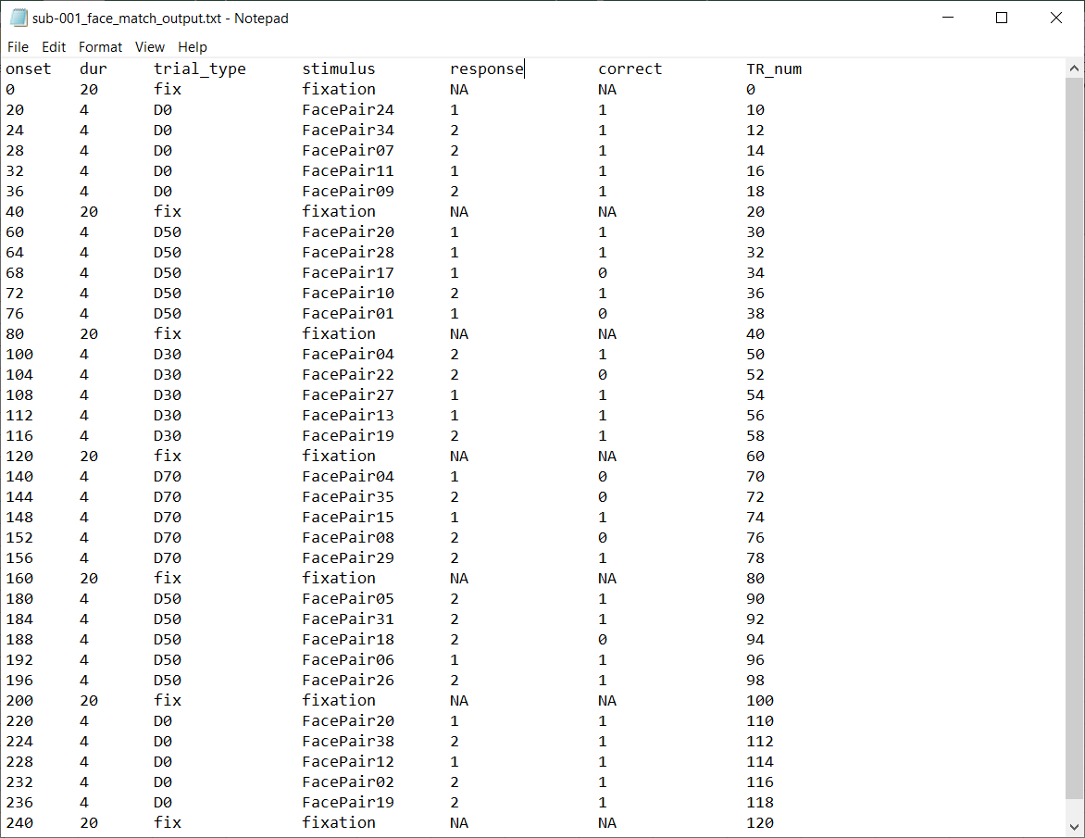

Slide 15
For Block Design:
Identify Block Onset & Block Duration
D0 Blocks start at TRs # 10 & 110
D50 Blocks start at TRs # 30 & 90

Slide 16
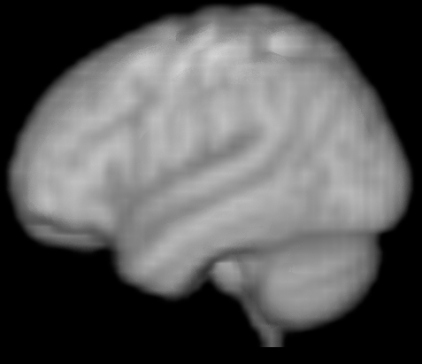
How to get a brain matrix

Slide 17
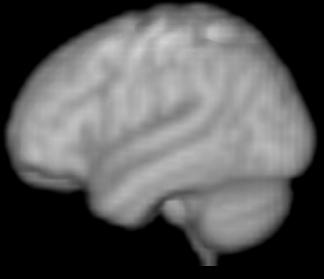
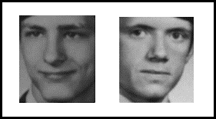
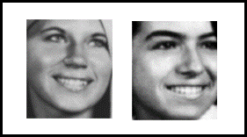
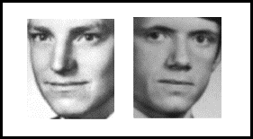
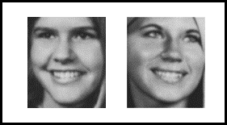
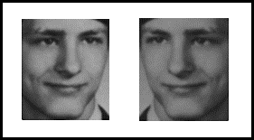
. . .
+
Time
D0 Block 1
voxel 1
voxel 2
voxel 3
voxel N
…
D0 Block 1 TR 1
…
D0 Block 1 TR 2
…
D0 Block 1 TR 3
…
D0 Block 1 TR 4
…
D0 Block 1 TR 5

Slide 18
For one participant
voxel 1
voxel 2
voxel 3
voxel N

Slide 19
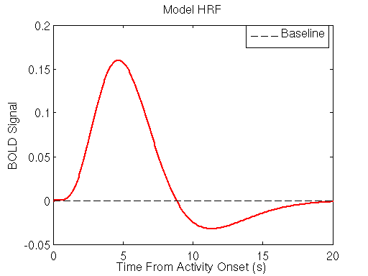
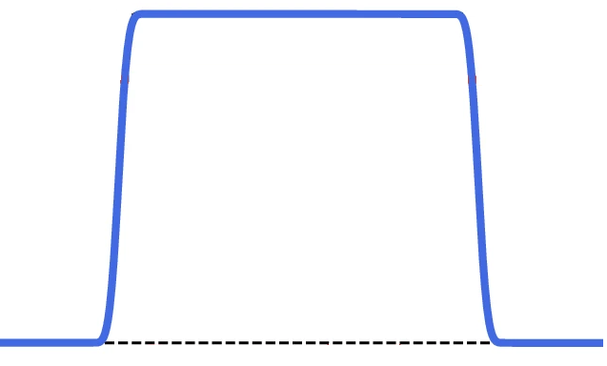
. . .
Hemodynamic Response Function (HRF)
+
D0 Block 1

Slide 20
. . .
+
D0 Block 2
voxel 1
voxel 2
voxel 3
voxel N
+
D50 Block 1
brain matrix for one participant
D0 Block 1

Slide 21
Final X (brain) & Y (design)
Voxel 1
Voxel N
Voxel 2
. . . . .
sub-001-young_faceTask.nii
sub-002-young_faceTask.nii
.
.
.
.
.
.
.
.
.
.
.
.
.
sub-030-old_faceTask.nii

Slide 22
Final X (brain) & Y (design)
Voxel 1
Voxel N
Voxel 2
. . . . .
sub-001-young_faceTask.nii
sub-002-young_faceTask.nii
.
.
.
.
.
.
.
.
sub-030-old_faceTask.nii

Slide 23
Mean-Centered PLS
AKA Task PLS, Barycentric Discriminant Analysis
Akin to a univariate ANOVA to examine condition and/or group differences
Different mean-centering options
0: remove group means from conditions means (boost conditions)
1: remove condition mean from each group mean (boost groups)
2: remove grand mean (boost interaction)
3: remove condition and group means (interaction w/o main effects)
See User Guide!

Slide 24
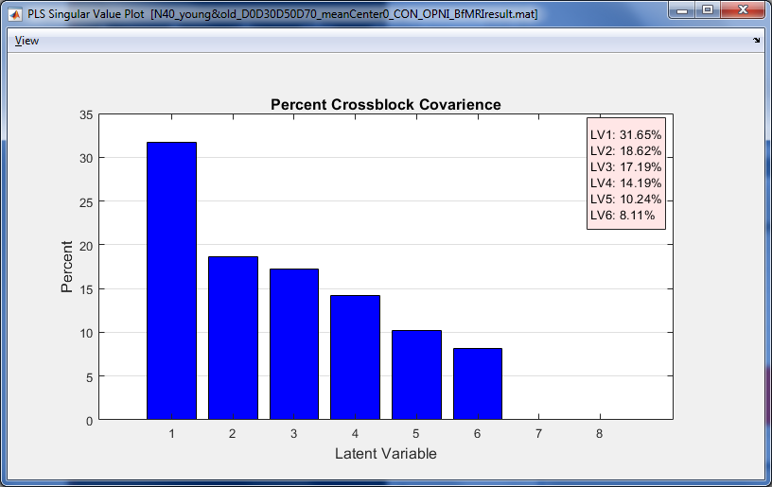
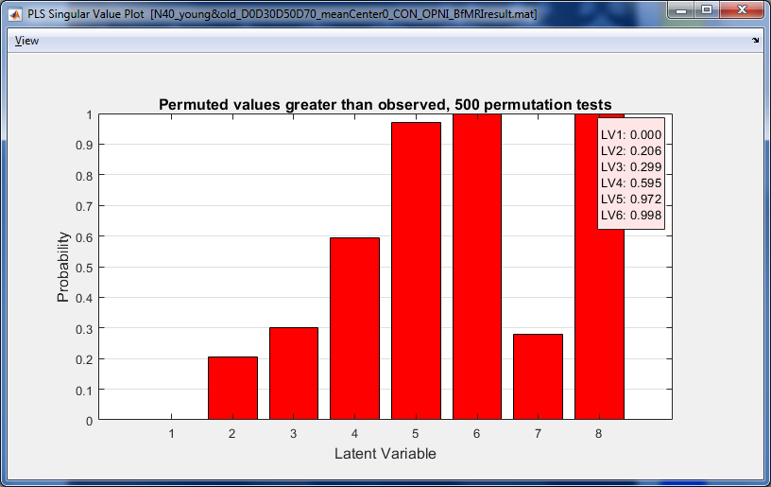
PLS Singular Value Plot
LV 1 explains 31% covariance between task design and activity, p < .002
PLS Singular Value Plot
Permutation to determine which latent variables to interpret

Slide 25
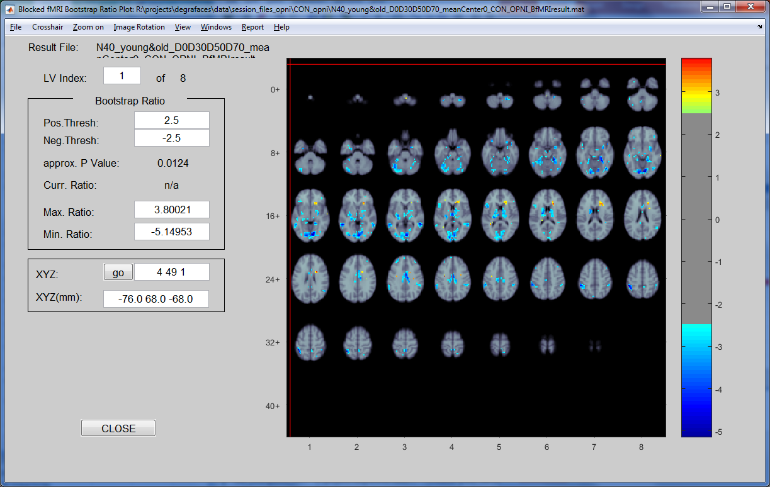
Mean-Center by group (type 0) Significant voxels contributing to LV 1
Set BSR thresholds
Bootstrap Ratios (BSRs) to determine which voxels are significant
Notes:
0 - (default) Within each group remove group means from conditon means. Tells us how conditions are modulated by group membership. Boosts condition differences, removes overall group differences. Best suited if you are interested in condition and condition- by-group effects.

Slide 26
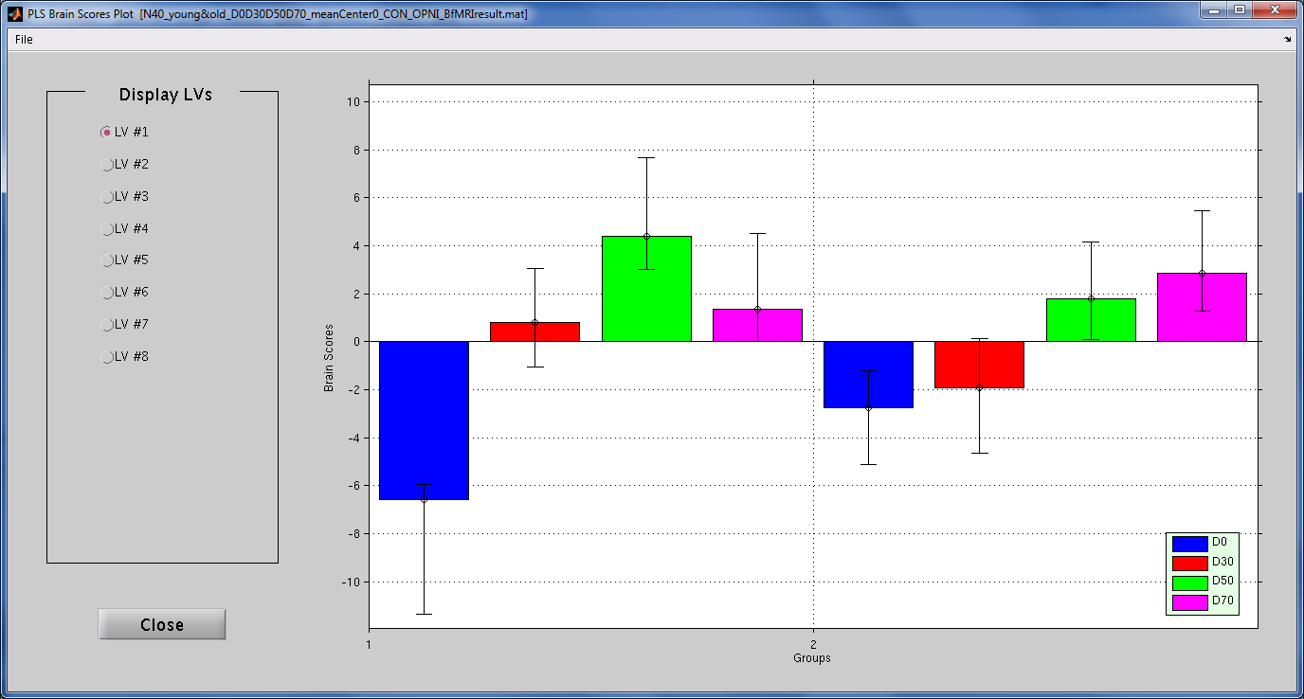
Mean-Center by group (type 0) Significant conditions/groups contributing to LV 1
PLS Brain Scores Plot
Bootstrapped
Confidence Intervals to determine which groups/conditions contribute
D0 vs D50
D0 vs D70
Young Adults
Older Adults

Slide 27

Interpreting fMRI-condition relationships
Negative BSRs
How does activation for each condition map onto the LV?
Brain Scores for Young
Notes:
48 -48 4 – middle temporal

Slide 28
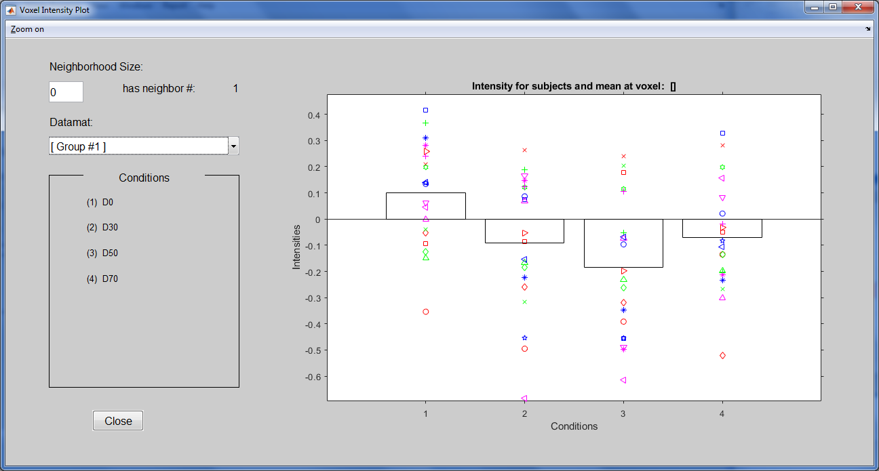
Interpreting fMRI-condition relationships
Negative BSRs
How does activation for each condition map onto the LV?
Brain Scores for Young
Voxel Intensity Plot
Mean % signal change
in selected voxel (L middle temporal) for young adults across the 4 conditions
Notes:
Voxel Intensity Plot
48 -48 4 – middle temporal

Slide 29
Interpreting fMRI-condition relationships
Negative BSRs
Negative BSR & Negative design score indicates a positive relationship
Brain Scores for Young
Voxel Intensity Plot
Mean % signal change
in selected voxel (L middle temporal) for young adults across the 4 conditions
Notes:
48 -48 4 – middle temporal

Slide 30
Interpreting fMRI-condition relationships
Negative BSRs
Negative BSR &
Positive design score indicates a negative relationship
Brain Scores for Young
Voxel Intensity Plot
Mean % signal change
in selected voxel (L middle temporal) for young adults across the 4 conditions
Notes:
48 -48 4 – middle temporal

Slide 31
Block Design Mean-Centered PLS Summary
PLS is powerful for block design
Nature of the hemodynamic response
Allows you to analyze condition and/or group differences
BUT be mindful of mean centering options
Different centering techniques can boost group vs condition differences

Slide 32
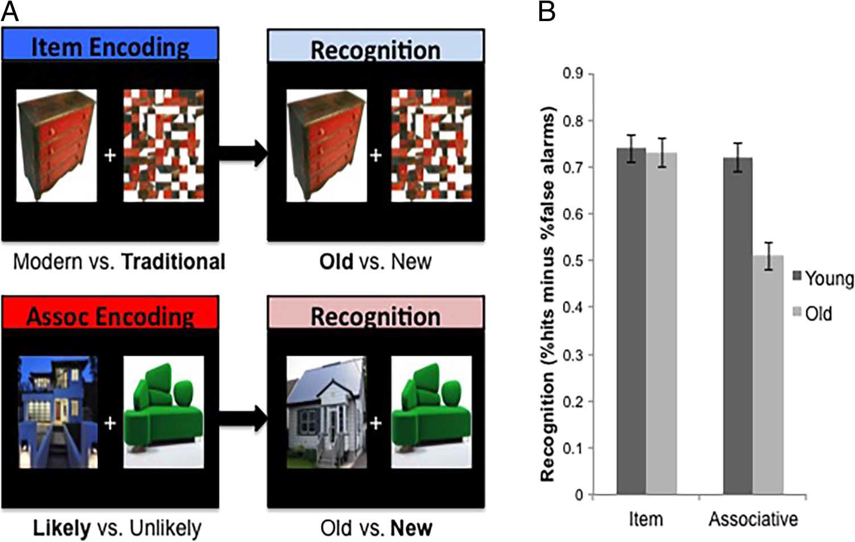
Event-Related Behavioral PLS
Saverino et al., 2016, J Cog Neurosci
Sample: N = 15 Younger Adults; N = 16 Older Adults
Incidental encoding paradigm
Surprise Recognition test
outside of scanner
Behavior as: Hits – False Alarms
but “behavior” can be many things
In-Scanner Encoding
Out-of-Scanner Recognition
Modern vs.
Traditional
Old vs. New
Likely vs.
Unlikely

Slide 33
Subsequent Memory Task Questions
What profile of activity during successful incidental item and paired associates encoding is correlated with better subsequent memory?
How do brain-behavior relationships differ between young and older adults?
What is the timecourse of activity during successful encoding events (and does it differ with age?)

Slide 34
. . . . .
Item Hit (aka subsequently remembered)

Slide 35
. . . . .
Item Hit (aka subsequently remembered)
0
%Δ
%Δ
%Δ
%Δ

Slide 36
Item Hit (aka subsequently remembered)
voxel 1
voxel 2
Item Hit Red Dresser
0
%Δ
%Δ
%Δ
%Δ
0
%Δ
%Δ
%Δ
%Δ

Slide 37
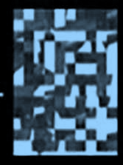
. . . . .
Item Hit (aka subsequently remembered)
voxel 1
voxel 2
Item Hit Red Dresser
Item Hit Blue House
0
%Δ
%Δ
%Δ
%Δ

Slide 38
. . . . .
Item Hit (aka subsequently remembered)
voxel 1
voxel 2
Item Hit Red Dresser
Item Hit Blue House
0
%Δ
%Δ
%Δ
%Δ
0
%Δ
%Δ
%Δ
%Δ

Slide 39
. . . . .
Item Hit (aka subsequently remembered)
Item Hit (aka subsequently remembered)
voxel 1
voxel 2
Item Hit Red Dresser
Item Hit Blue House

Slide 40
Event-related brain X (single subject)
voxel 1
voxel 2
voxel N
Item Hit #1
. . .
. . .
Item Hit #2
. . .
. . .
Item Hit #N
. . .
. . .
Associative Hit #1
. . .
. . .
Associative Hit #N
. . .
. . .
Lag 0
Lag 1
Lag 2
Lag 3
. . .
. . .
Lag 4
Lag 0
Lag 1
Lag 2
Lag 3
Lag 4
Lag 2
Lag 3
Lag 4

Slide 41
Event-related brain X (single subject)
Voxel_{N} Lag2
Voxel_{N} Lag3
Voxel₁ Lag0
Voxel_{N} Lag4
Voxel₁ Lag1
Voxel₁ Lag2
Voxel₁ Lag3
Voxel₁ Lag4
Voxel₂ Lag0
Voxel₂ Lag1
Voxel₂ Lag2
Voxel₂ Lag3
Voxel₂ Lag4
Mean Item Hits
. . .
Mean Assoc. Hits
. . .

Slide 42
Final X (brain) and Y (behavior)
MemoryScore
Voxel_{N} Lag2
Voxel_{N} Lag3
Voxel₁ Lag0
Voxel_{N} Lag4
Voxel₁ Lag1
Voxel₁ Lag2
Voxel₁ Lag3
Voxel₁ Lag4
Voxel₂ Lag0
Voxel₂ Lag1
Voxel₂ Lag2
Voxel₂ Lag3
Voxel₂ Lag4
sub-001-YNG Item Hits
. . .
.78
sub-001-YNG Assoc Hits
. . .
.72
.
.
sub-002-YNG Item Hits
. . .
.65
. . .
.
.
sub-002-YNG Assoc Hits
.78
.
.
sub-031-OLD Item Hits
. . .
.82
sub-031-OLD Assoc Hits
. . .
.62

Slide 43
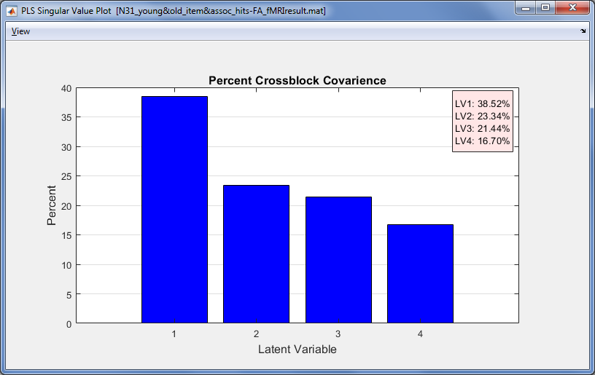
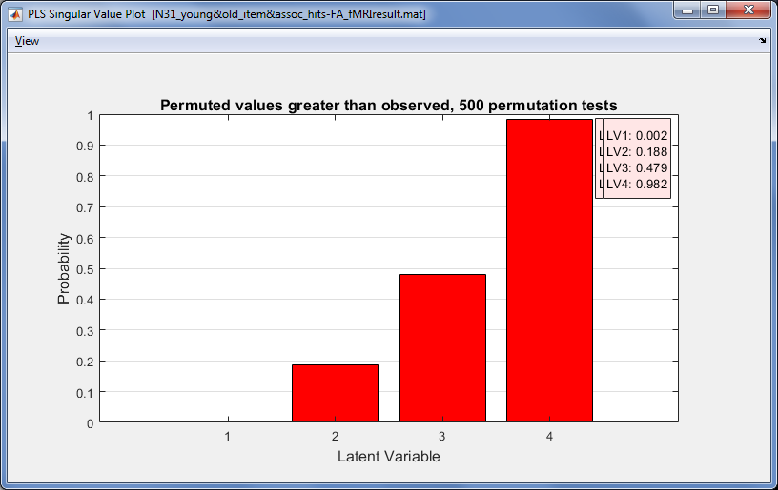
PLS Singular Value Plot
LV 1 explains 38.5% covariance between task performance and brain activity, p = .002
PLS Singular Value Plot
Permutation to determine which latent variables to interpret

Slide 44
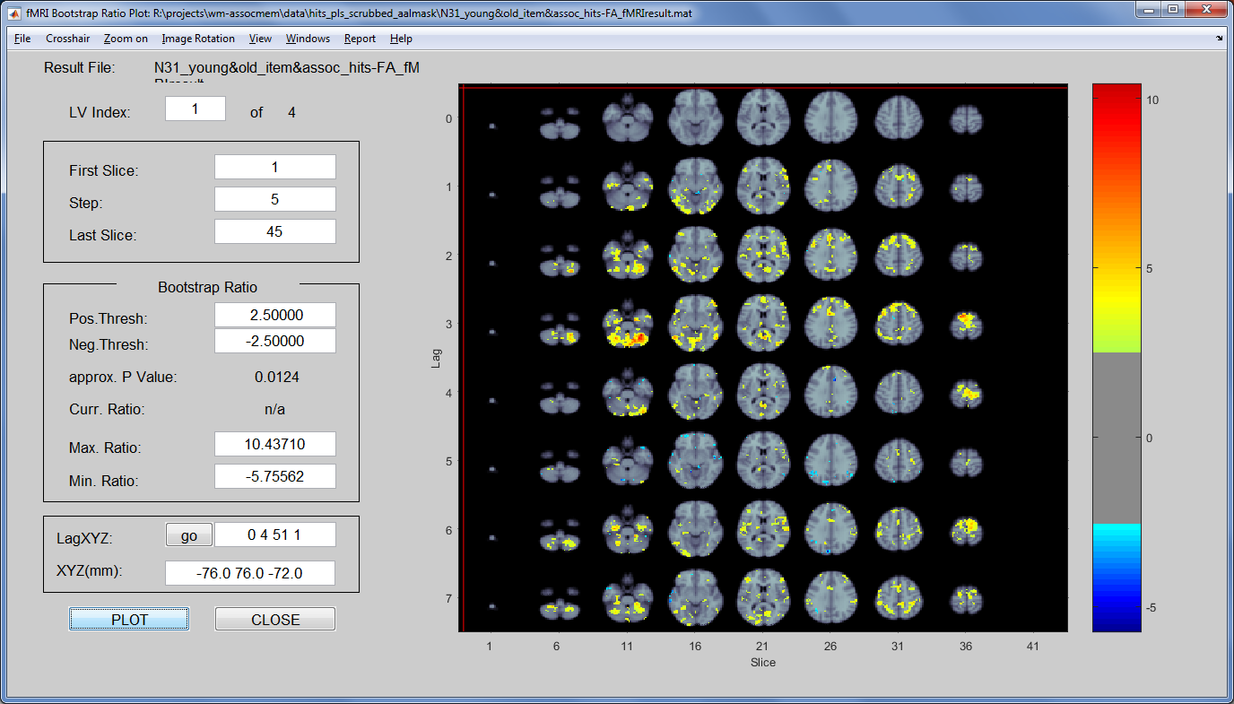
Significant voxels contributing to LV 1
Bootstrap Ratios (BSRs) to determine which voxels are significant

Slide 45
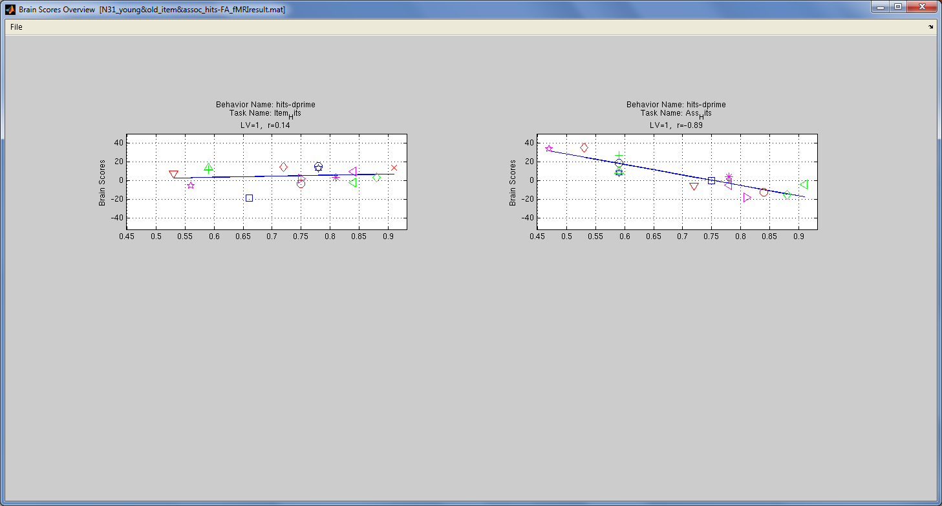
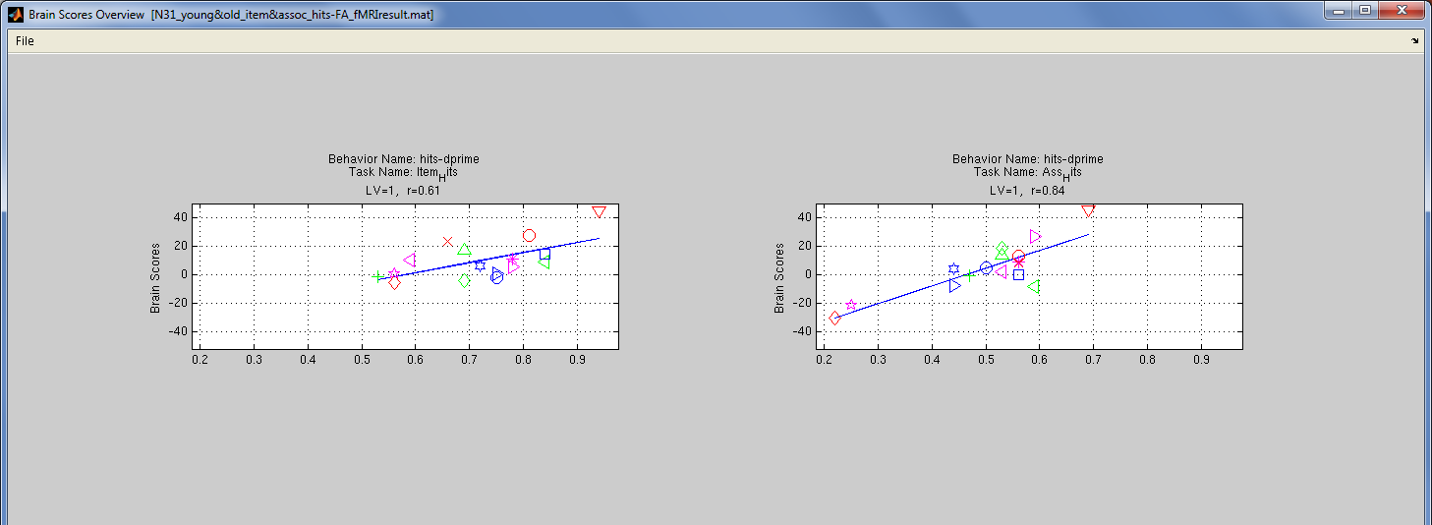
Correlations between behavior and activity on LV1
Plot Brain Scores Overview
Younger Adults
ItemScore
AssociativeScore
Older Adults
ItemScore
AssociativeScore

Slide 46
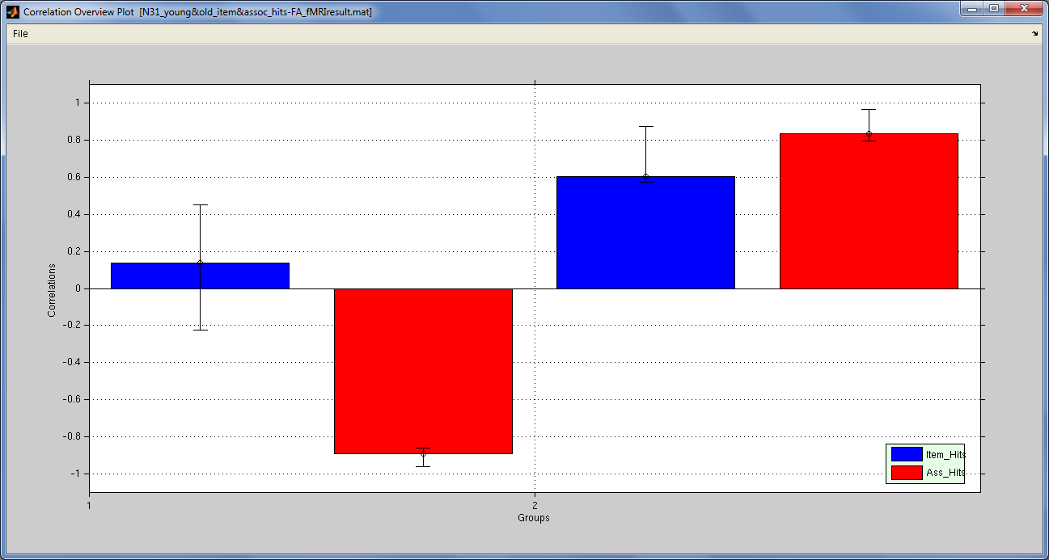
Significant Brain-Behavior correlations contributing to LV 1
Plot Brain Scores Overview
> Correlation Overview Plot
Bootstrapped
Confidence Intervals to brain-behavior relationships are significant
Young Adults
Older Adults

Slide 47
Interpreting Brain-Behavior correlations
Correlations between behavior & BrainScores
Young Adults
Older Adults
Young Adults show a negative correlation between Associative Memory Scores and Brain Scores
Increased associative memory performance is correlated with decreased activity during encoding in hot regions

Slide 48
Interpreting Brain-Behavior correlations
Correlations between behavior & BrainScores
Young Adults
Older Adults
Older Adults show a positive correlation between
Item and Associative Memory Scores and Brain Scores
Increased item and associative memory performance is correlated with increased activity during encoding in hot regions

Slide 49
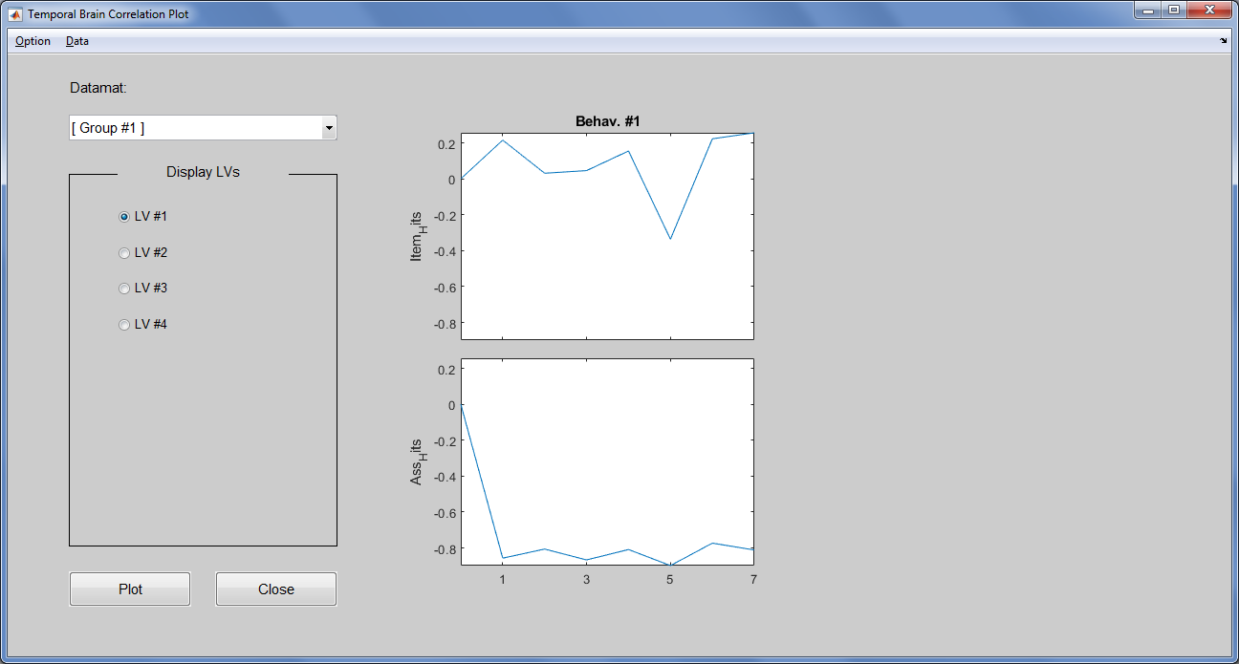
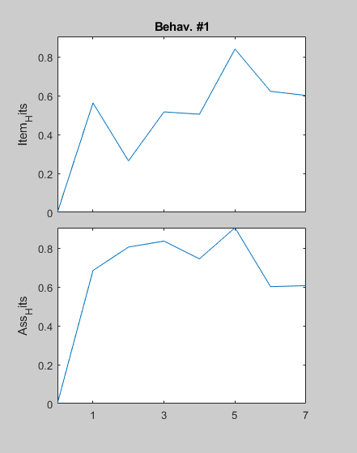
Examining the Time Course of the brain-behavior relationships
Temporal Brain Correlation Plot
Young Adults
Older Adults
Temporal Lag
Temporal Lag

Slide 50
Event-Related Behavioral PLS Summary
Way to examine behavioral (or other) correlates of activity patterns in relation to task design/participant groups
More to interpret with event-related designs
BUT can examine how brain-behavior relationships change over time (i.e., hemodynamic response)

Slide 51

Not-quite-brain-volumes
Functional Connectivity Matrix
Motor-DAN
Motor-Frontal
Motor-DMN
Motor-VAN
Visual-Motor
Motor-SUB
Visual-DAN
Visual-Frontal
Visual-DMN
Visual-VAN
Visual-SUB
DAN-Frontal
DAN-DMN
DAN-VAN
DAN-SUB
Visual
Motor
DAN
Frontal
DMN
VAN
SUB
Visual
Motor
DAN
Frontal
DMN
VAN
SUB

Slide 52



Handling not-quite-brain-volumes
Multiple Functional Connectivity Matrices
…
…
…
…

Slide 53
Using the command line functions
> pls_results = pls_analysis({X}, n_sub, n_cond, pls_options);
pls_options to specify type of PLS, “behavioral” data
Refer to User Guide for how PLS expects X to be setup
Command line output:
Results in “vectorized” format so keep track of you generated your brain X
> pls_results.perm_result.sprob % permutation p-vals
> pls_results.boot_result.compare_u % BSR
> pls_results.boot_result.usc % brain scores
> pls_results.boot_result.ulusc/llusc % CIs for mc PLS
> pls_results.boot_result.orig_corr % for beh PLS
> pls_results.boot_result.ulcorr/llcorr % CIs for beh PLS

Slide 54
Tools for conducing PLS outside of MatLab
R Packages
oro.nifti
neuroim
TExPosition
Python
nipy
nilearan
scikit-learn

Slide 55
Resources
PLS User Guide & Fourm
http://pls.rotman-baycrest.on.ca/UserGuide.htm
See our previous RTC Workshop for more in-depth examples & code
https://github.com/derekbeaton/workshops/
Suggested Readings:
Krishnan et al., (2011). Partial Least Squares (PLS) methods for neuroimaging: A tutorial and review. NeuroImage
McIntosh & Lobaugh (2004). Partial least squares analysis of neuroimaging data - applications and advances. NeuroImage
McIntosh & Misic (2013). Multivariate Statistical Analyses for Neuroimaging Data. Annual Review of Psychology
Abdi & Williams (2010). Principal component analysis

